Slide 1

The Fourth Hour!
Welcome to…

Slide 2
Introduction
Welcome to the Fourth Hour!
Name
Professor
A fun fact about you

Slide 3
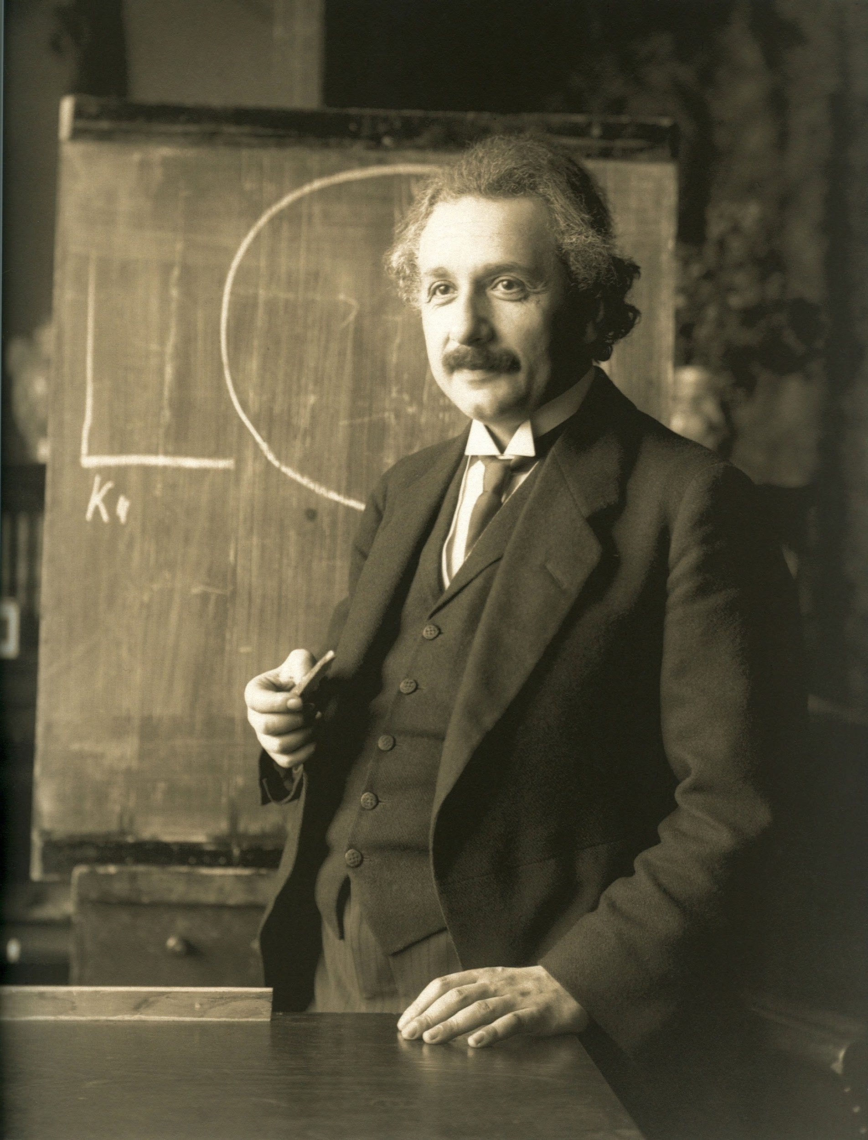
“Anyone who has never made a mistake has never tried anything new.”

Slide 4
Comparison and Relational Operators
You can only compare things of the same type
12 >= 5 # True
4 < 2 # False
“Hey” < 4 # TypeError

Slide 5
Comparison and Relational Operators
You can only compare things of the same type
12 >= 5 # True
4 < 2 # False
“Hey” < 4 # TypeError
Except when we compare floats and ints, ints are automatically converted to float
12.0 >= 5 # True
4 < 2.0 # False

Slide 6
Comparison and Relational Operators
If we can’t use < or > to compare strings then how do we?

Slide 7
Comparison and Relational Operators
If we can’t use < or > to compare strings then how do we?
We use ==

Slide 8
Comparison and Relational Operators
If we can’t use < or > to compare strings then how do we?
We use ==
For example, if we want to see if two Strings are equal we do:
“Testing” == “Testing” # True
“Week 7” == “week 7” # False
Important to note: NEVER use == to compare floats this will cause unreliable results
Notes:
NEVER use == to compare floats. Floating point arithmetic is not exact, so the results can be confusing.

Slide 9
Review
Login to Socrative at https://b.socrative.com/login/student/
Use code 4thHour149

Slide 10
Question 1
What does the following code print?
print("7" == 4+3)
True
False
7
Error

Slide 11
Question 1
What does the following code print?
print("7" == 4+3)
True
False
7
Error

Slide 12
Comparison and Relational Operators
One more comparison operator… is
is returns true if both operands refer to the exact same object
Notes:
NEVER use == to compare floats. Floating point arithmetic is not exact, so the results can be confusing.

Slide 13
Comparison and Relational Operators
One more comparison operator… is
is returns true if both operands refer to the exact same object
What does this mean?
Notes:
NEVER use == to compare floats. Floating point arithmetic is not exact, so the results can be confusing.

Slide 14
Comparison and Relational Operators
One more comparison operator… is
is returns true if both operands refer to the exact same object
What does this mean?
Well, let’s look at an example
Notes:
NEVER use == to compare floats. Floating point arithmetic is not exact, so the results can be confusing.

Slide 15
Comparison and Relational Operators
lst1 = []
lst2 = []
if (lst1 == lst2 ):
print("True")
else:
print("False")
if (lst1 is lst2 ):
print("True")
else:
print("False")
Well, let’s look at an example
The output of this code is:
True
False
lst1 and lst2 are equivalent but not exactly the same list
Notes:
NEVER use == to compare floats. Floating point arithmetic is not exact, so the results can be confusing.

Slide 16
Boolean Operators
and is True only if both operands are True
3 == 3 and 2 < 5 # True
3 > 1 and 5 > 6 # False

Slide 17
Boolean Operators
and is True only if both operands are True
3 == 3 and 2 < 5 # True
3 > 1 and 5 > 6 # False
or is True if either or both operands are True
3 == 3 or 2 < 5 # True
3 > 1 or 5 > 6 # True
12 < 2 or 1 > 2 # False

Slide 18
Boolean Operators
The final operator we will discuss is the not operator
The not operator will invert any boolean
not(True) # False
not(1 > 3 and 1 < 10) # True
not(“test” == “test” or 31<2) # False

Slide 19
Question 2
What does the following print?
str1 = "Heyo"
print(not(20 <= 34) or True and (str1=="Heyo"))
True
False
Other
Error

Slide 20
Question 2
What does the following print?
str1 = "Heyo"
print(not(20 <= 34) or True and (str1=="Heyo"))
True
False
Other
Error

Slide 21
if Statements
if the condition in the if statement is True, then the code executes otherwise it is skipped.
if True:
print(“1”)
print(“2”)
1
2

Slide 22
if Statements
You can use expressions that evaluate to Booleans, for example:
str = “Hi”
if str == “Hi”:
print(“Hey”)
Hey

Slide 23
if/else Statements
By using the keyword else after an if statement we can do more advanced logic
The code in the body of the else statement runs if the first condition is False
str = “Hello”
if str == “Hi”:
print(“Hey”)
else:
print(“Bye”)
Bye

Slide 24
if/elif Statements
Similar to the else statement, the elif allows for further logic
The code in the body of the elif statement runs if the previous condition is False and the statement inside the elif is True
str = “Bye”
if str == “Hi”:
print(“Hey”)
elif str == “Bye:
print(“Bye”)
Bye

Slide 25
if/else/elif Statements
if, else, and elif can be combined together
str = “Yo”
if str == “Hi”:
print(“Hey”)
elif str == “Bye”:
print(“Bye”)
else:
print(“unknown input”)
unknown input

Slide 26
Question 3 - PI
num = 12
if num < 15:
print(“less than 15”)
if (num < 10):
print(“less than 10”)
else:
print(“greater than 10”)
What is printed?
“Less than 15”
“less than 15
less than 10
greater than 10”
“less than 15
greater than 10”
“”

Slide 27
Question 3 - PI
num = 12
if num < 15:
print(“less than 15”)
if (num < 10):
print(“less than 10”)
else:
print(“greater than 10”)
What is printed?
“Less than 15”
“less than 15
less than 10
greater than 10”
“less than 15
greater than 10”
“”

Slide 28
Question 4
num = 12
if num < 20:
print(“A”)
elif num > 40:
print(“B”)
else:
print(“C”)
print(“D”)
What is printed?
(Assume space is newLine)
A
A D
A B C D
D

Slide 29
Question 4
num = 12
if num < 20:
print(“A”)
elif num > 40:
print(“B”)
else:
print(“C”)
print(“D”)
What is printed?
(Assume space is newLine)
A
A D
A B C D
D

Slide 30
Things to Avoid
var1, var2 = 1, 2
if var1 == 0:
if var2 == 0:
print(“Both are 0”)
Instead
var1, var2 = 1, 2
if var1 == 0 and var2 == 0:
print(“Both are 0”)

Slide 31
Things to Avoid
var1 = 100
if var1 > 0:
return True
else:
return False
Instead
var1 = 100
return var1 > 0

Slide 32
Things to Avoid
var1 = True
if var1 == True:
print(“True”)
Instead
var1 = True
if var1:
print(“True”)

Slide 33
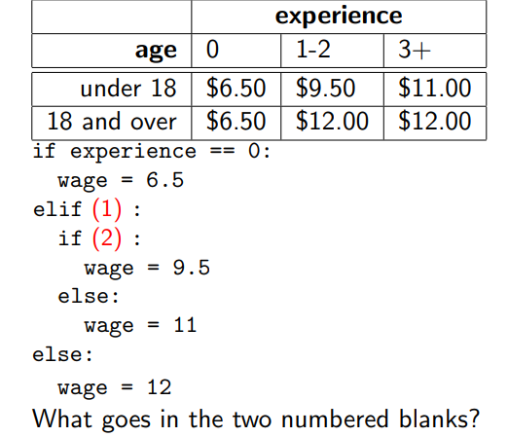
Question 5 - PI
(1) experience > 0 (2) experience >= 1
(1) age < 18 (2) experience != 3
(1) age < 18 (2) experience == 1 or experience == 2
Notes:
Trace this

Slide 34
Question 5 - PI
(1) experience > 0 (2) experience >= 1
(1) age < 18 (2) experience != 3
(1) age < 18 (2) experience == 1 or experience == 2
Notes:
Trace this

